Slide 1
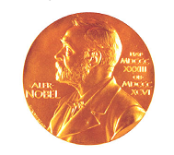
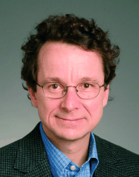
Structure & Function of
K⁺ Channels
Roderick MacKinnon et al. 1998 -
Nobel prize in Chemistry 2003

Slide 2
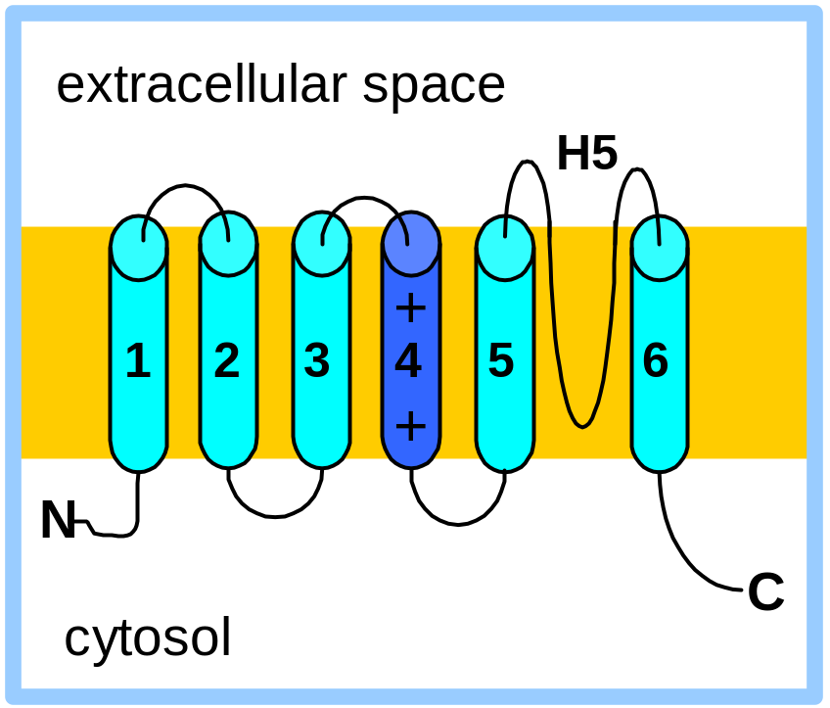
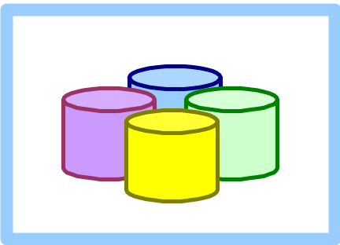
Hydropathy analysis & topology studies predicted the presence of 6 transmembrane α-helices in the voltage-gated K⁺ channel protein.
The core of the channel consists of helices 5 & 6 & the intervening H5 segment of each of the 4 copies of the protein.
H5 includes a consensus sequence
(Thr-Val-Gly-Tyr-Gly) found in all K⁺ channels, with only minor changes through evolution.

Slide 3
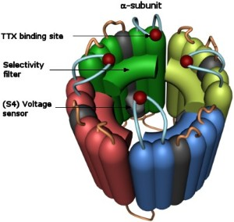
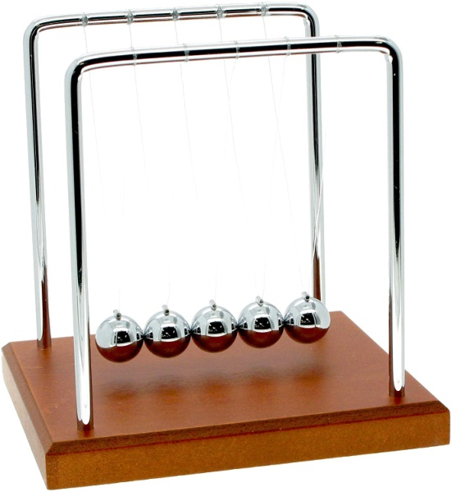
K⁺ channels are highly optimized for the selective conductance of K⁺ ions.
Selectivity is realized by compensating the energetic cost for K⁺ ions dehydration.
Two K⁺ ions oscillate within the filter as in a Newton’s cradle.
Negative charges increase the conductance by raising the local K⁺ conc.
Positive charges are used for voltage sensing.
Separation of properties (selectivity, conductance and gating) allows different channels to use the same mechanisms throughout the tree of life.
Structure & Function of K⁺ Channels

Slide 4
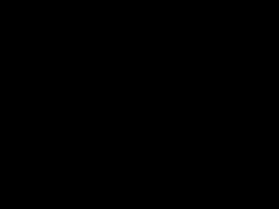

Slide 5
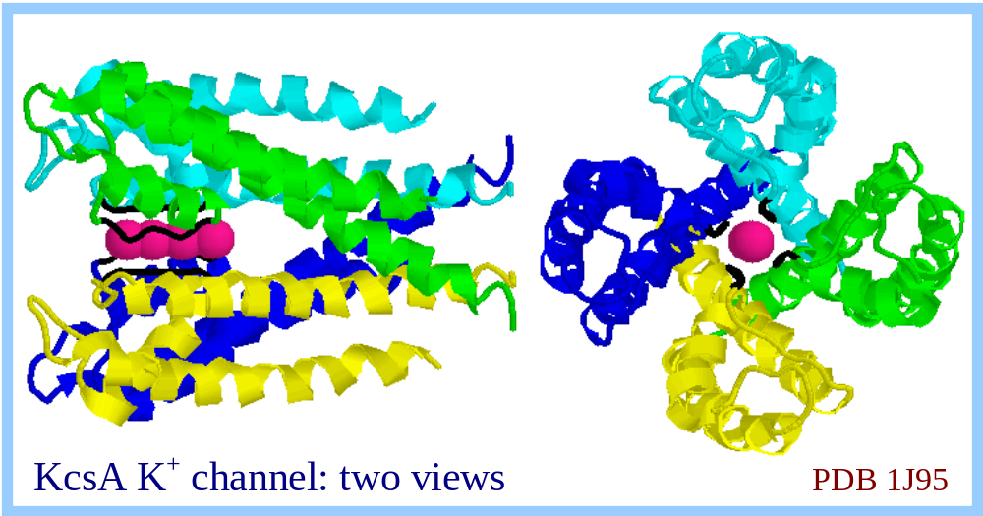
Left:
side view, normal to membrane.
Right:
view from the extra- cellular space.
The K⁺ channel consensus sequence (in black) forms the selectivity filter at the narrowest part of the channel.
K⁺ ions are bound within the selectivity filter (color pink).
The gate is where the innermost α-helices of the 4 subunits meet at the narrow end of the "teepee" structure.
This is the closed channel.

Slide 6
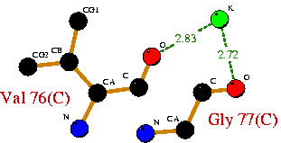
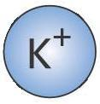

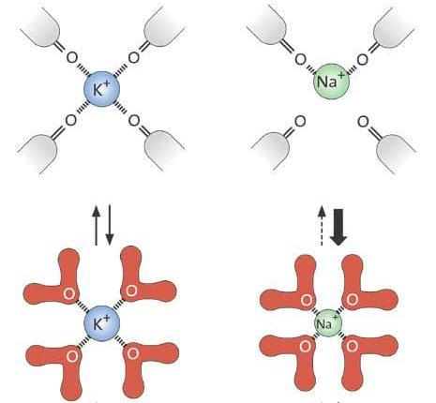
Beautifully elegant selectivity
The fixed filter structure is fine-tuned to accommodate a K⁺ ion.
It cannot shrink enough to properly bind the smaller Na⁺ ions.
Therefore, the energetic cost for dehydration is higher for Na⁺ ions.
Hence selectivity achieved.
266 pm
190 pm
Structure & Function of K⁺ Channels

Slide 7
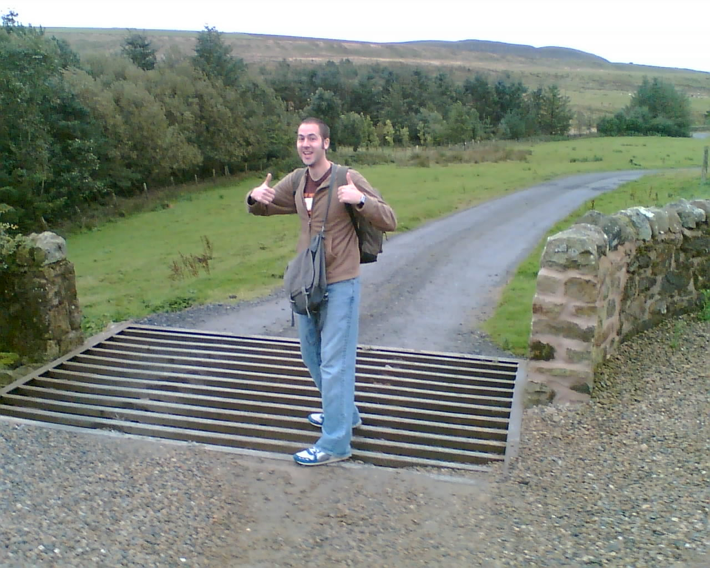
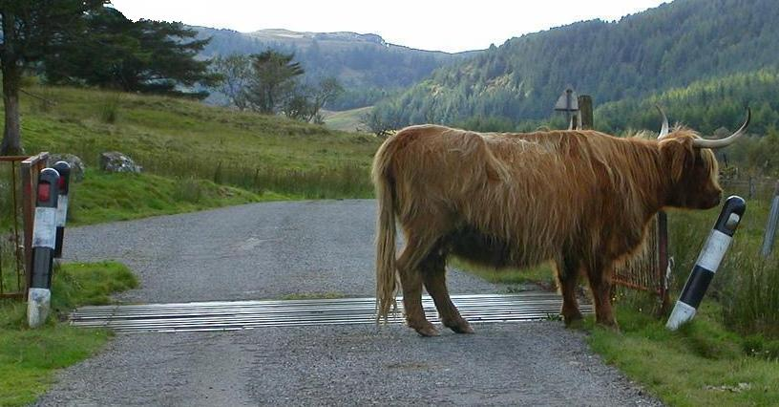
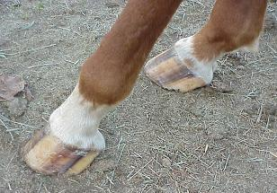
– cattle grids!
Humans found a similar solution to a similar problem…
The problem - passing big feet, blocking small feet.
The solution?
30.01.2007
Structure & Function of K⁺ Channels

Slide 8
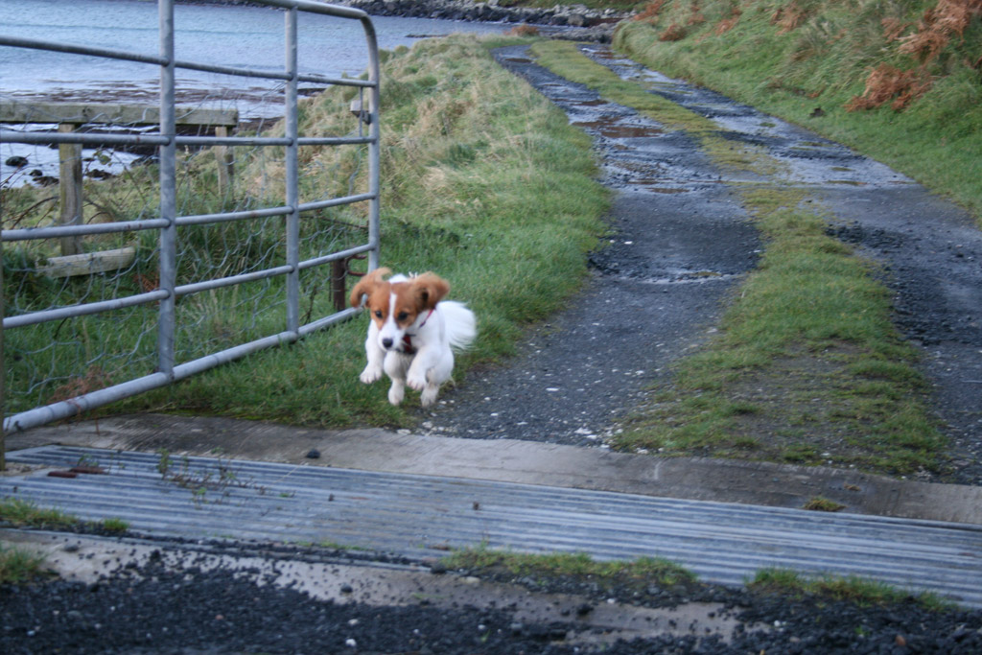
30.01.2007
Structure & Function of K⁺ Channels

